Slide 1
Software Performance for Object-Oriented Design

Slide 2
Agenda
Software Performance Engineering (SPE) Process for Object-Oriented Systems
Specific Performance Focuses for OO Design
I/O, CPU, network bandwidth, and other resource utilizations
Temporal and spatial costs of data structure and algorithm in OO Design
Inheritance, composition, and procedure comparison
OO design tips
Garbage collection and Performance

Slide 3
SPE Process for OO Systems
Assess performance risk
Identify critical use cases
Select key performance scenarios
Establish performance objectives
Model-based performance evaluation (details should go to 345)

Slide 4
Assess Performance Risks
Assessing the performance risk at the beginning of the project provides estimation of future effort
Insufficient scalability
Inadequate resource
Network overhead
Third-party dependencies
Environmental factors
Human errors
…
You can refer to similar software systems on the market or from your prior experience; It would be more significant effort for new projects

Slide 5
Identify Critical Use Cases
The critical use cases are those that are important to the safety and operation of the system, e.g. for safety:
e.g. fire alarm system should sound within 10 seconds of smoke detection in the U.S. (5 seconds in EU)
pushing the red button to stop a conveyor belt or escalator must cause it to stop very quickly to reduce risk of injury
For commercial systems,
response times of web-based systems used to trade securities in a volatile market
The identification of critical use cases should be risk-driven
Critical use cases are only a subset of the use cases in OO design

Slide 6
Select key performance scenarios
For each critical use case, the key performance scenarios are those that are executed frequently, or those that are critical to the perceived performance of the system
Each scenario corresponds to a workload
Scenarios could be analyzed based on sequence diagrams

Slide 7
Establish performance objectives
Identify and define performance objectives and workload intensities for each scenario selected previously
Performance objectives could be addressed by
Response time
Throughput
Constraints on resource usage
Workload specificizes the level of usage for the scenarios, such as arrival rate or number of concurrent users

Slide 8
Model-based Performance Evaluation
Construct performance models
Determine software resource requirements
Add computer resource requirements
Evaluate the model
Verify and validate the models
More about this will be covered in SSW 345

Slide 9
Performance Trade-offs in OO Design
Resource utilization
e.g. I/O, CPU, Bandwidth
Object Creation, Destruction, and Manipulation
Temporal and Spatial cost trade-offs
CPU vs Memory Usage tradeoffs
Example: DB index table takes up memory, but speeds up search
Exercise: use the Task Manager in Windows or or the Activity Monitor on Mac OS to see how applications use memory and CPU
Granularity of objects
Overhead with abstract, inheritance and polymorphism
More…

Slide 10
Java I/O and Performance
Java I/O API provides different classes and methods for reading from and writing to various data sources (e.g. files, network sockets, in-memory streams)
Efficiently utilizing the appropriate I/O APIs and classes plays a critical role in determining the performance in Java applications and OO design

Slide 11
Key Java I/O APIs
I/O Streams (Differentiate from video stream for example)
Byte Streams
Character Streams
Buffered Streams
Scanning and Formatting
I/O from the Command Line
Data Streams
Object Streams
File I/O
Reading, Writing, and Creating Files
Random Access Files
Walking the File Tree
Finding Files

Slide 12
Byte Streams and Character Streams
Programs use byte streams to perform input and output of 8-bit bytes
Closing a stream when it’s no longer needed to avoid serious resource leaks
It represents a kind of low-level I/O that you should avoid since it should only be used for the most primitive I/O
All other stream types are built on byte streams
Character stream I/O automatically translates Unicode to and from the local character set, i.e. usually an 8-bit superset of ASCII
Character streams are often "wrappers" for byte streams, which handle translation between characters and bytes.
Character I/O usually occurs in bigger units than single characters. One common unit is the line: a string of characters with a line terminator at the end.

Slide 13
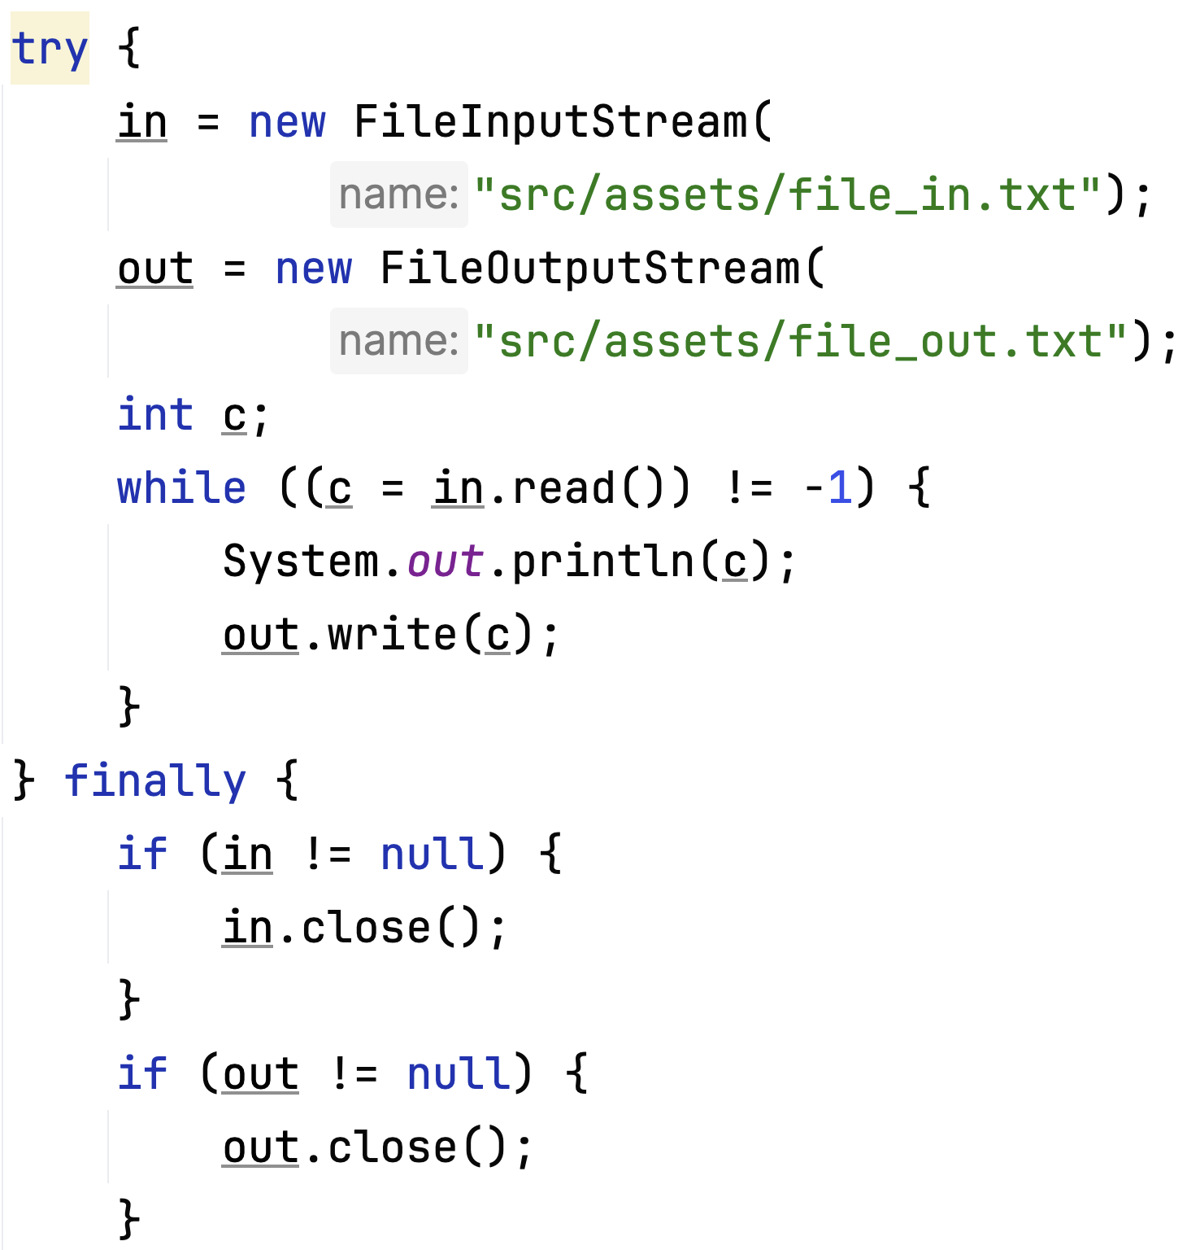
Byte Streams Example
Reading and writing files using byte streams
FileInputStream and FileOutputStream are derived from InputStream and OutputStream classes, which handles input and output streams of bytes.
The int variable c holds an 8-bit byte value

Slide 14
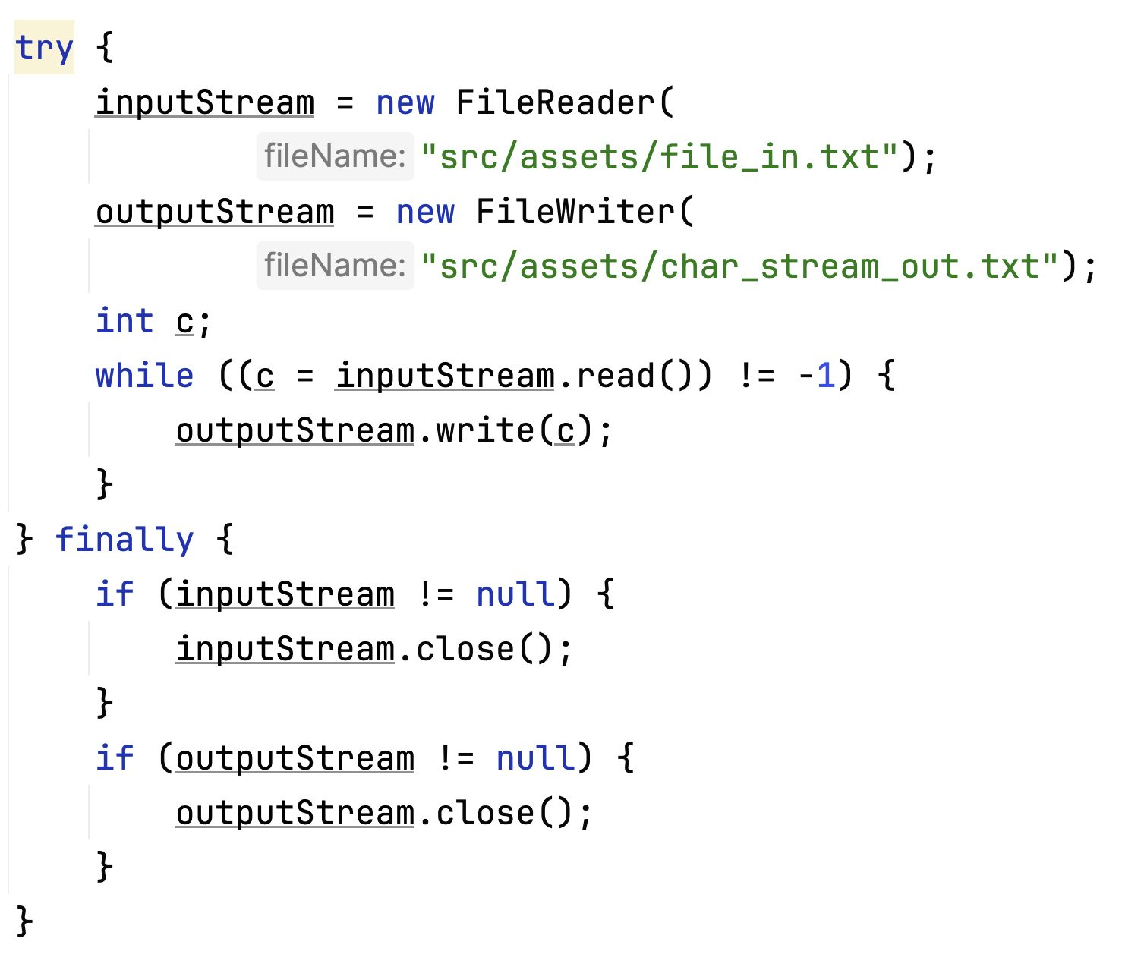
Character Streams Example
Character stream is similar to byte stream, but instead of using "FileInputStream" and "FileOutputStream", we are using "FileReader" and "FileWriter" classes.
They are derived classes from "Reader" and "Writer" classes, which handles character streams.
Integer variable c now holds a 16-bit character value, instead of an 8-bit byte value in the previous example

Slide 15
Buffered Streams
Previous stream examples use unbuffered I/O
Each read or write request is handled directly by underlying OS
This makes a program much less efficient due to disk access, network activity, etc.
Java platform implements buffered I/O streams, which reduces the related overhead by interacting with a memory area known as a buffer
A program can convert an unbuffered stream into a buffered stream using the wrapping idiom, where the unbuffered stream object is passed to the constructor for a buffered stream class.
inputStream = new BufferedReader(new FileReader("xanadu.txt"));
outputStream = new BufferedWriter(new FileWriter("characteroutput.txt"));

Slide 16
Data Streams and Object Streams
Data streams support binary I/O of primitive data type values (boolean, char, byte, short, int, long, float, and double) as well as String values.
Object streams support I/O of objects. Most, but not all, standard classes support serialization of their objects.

Slide 17
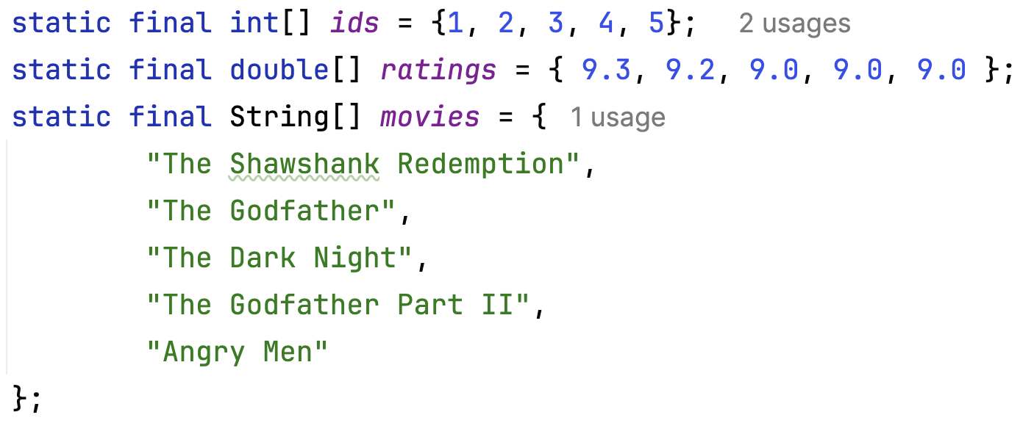
Data Streams Example
Let's initiate a few data structures representing IMDb's top 5 rated movies, their rating, and their ids

Slide 18
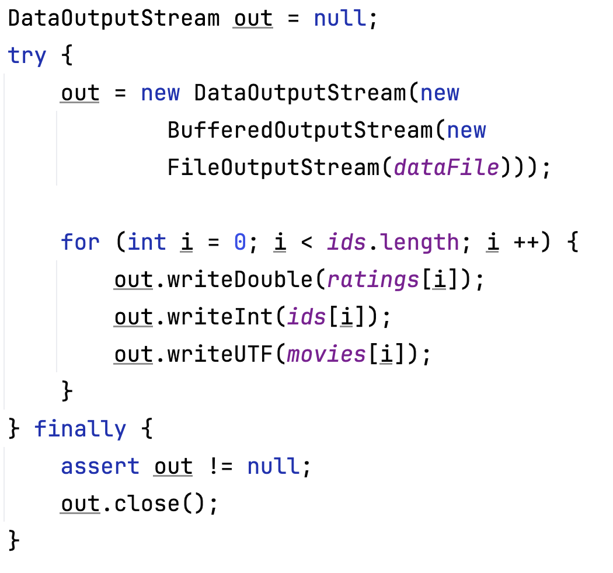
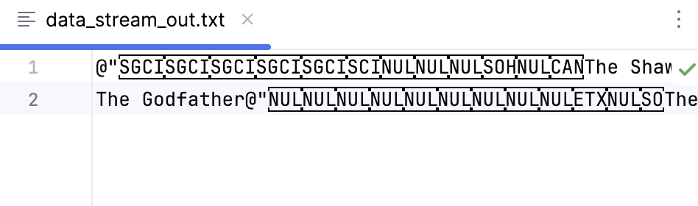
Data Streams Example cont'd
We can use a buffered output to write the data to file
Note: DataOutputStream writes data in ASCII, and it can be read correctly by DataInputStream.

Slide 19
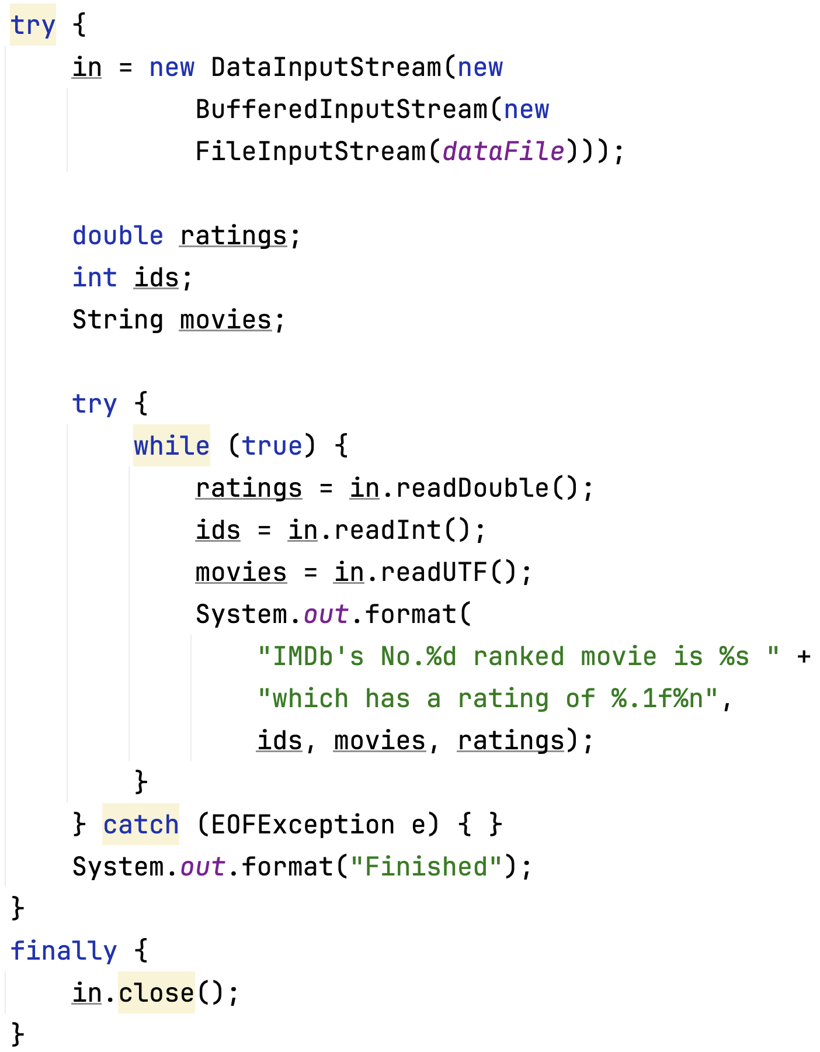
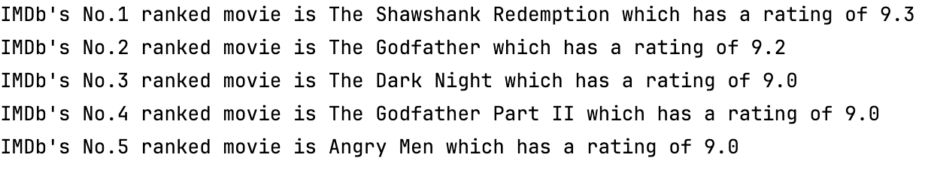
Data Streams Example cont'd
The data fields must be read in the same order which they are saved when reading a file.
We wrote out "ratings -> ids -> movies", so we have to read in the same order.

Slide 20
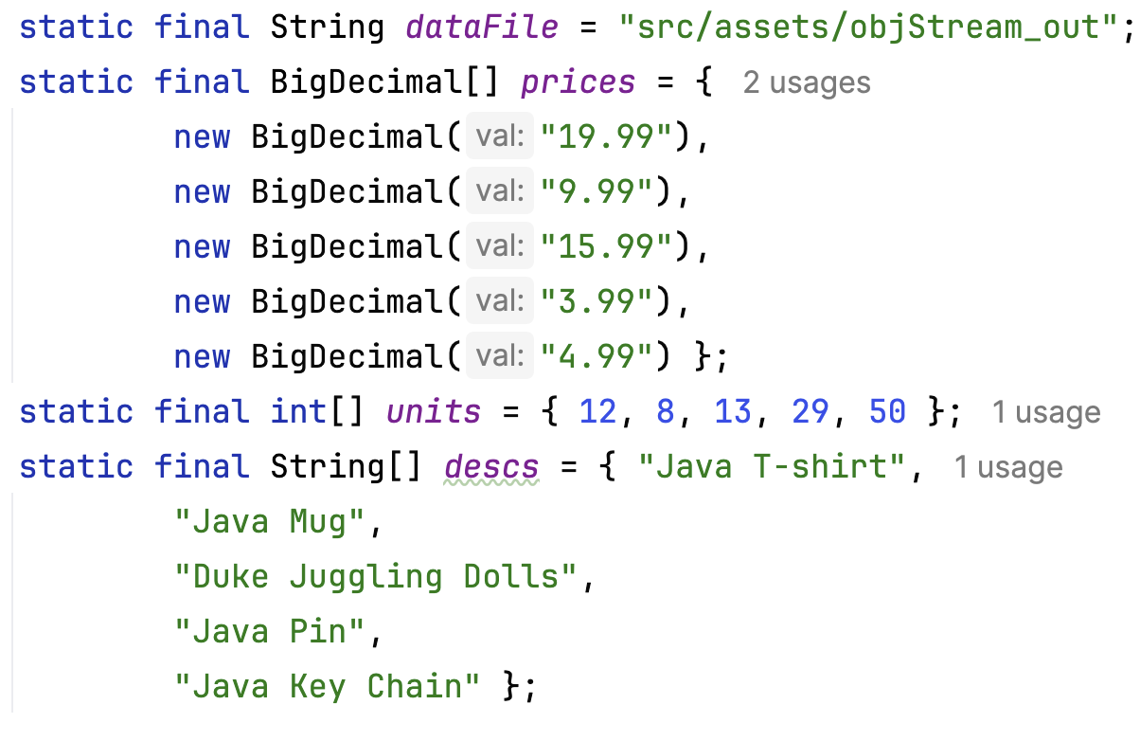
Object Streams
Let's initialize a data structure representing an invoice with item name, unit prices, and number of units
Note that prices is a "BigDecimal" which is not a primitive data supported by DataOutputStream.
We have to use ObjectOutputStream to write to files.
When writing an object to file, the file needs no extension

Slide 21
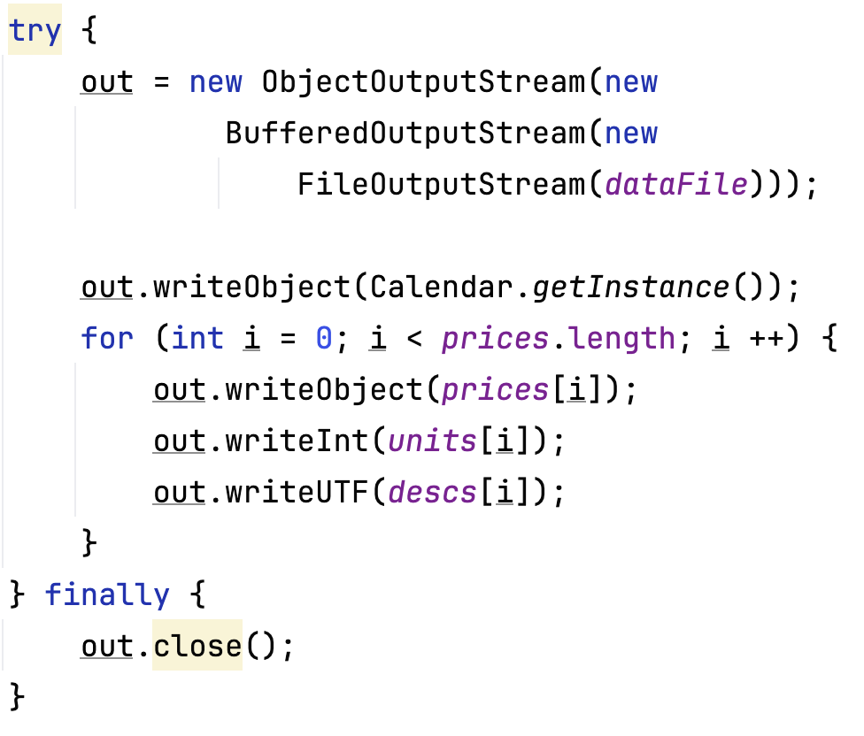
Object Streams
We can write the data structures into an object file, then read it when needed. It's a lightweight method of persisting a Java object.
Continue with our example, let's also add today's date to keep track when the invoice is created:

Slide 22
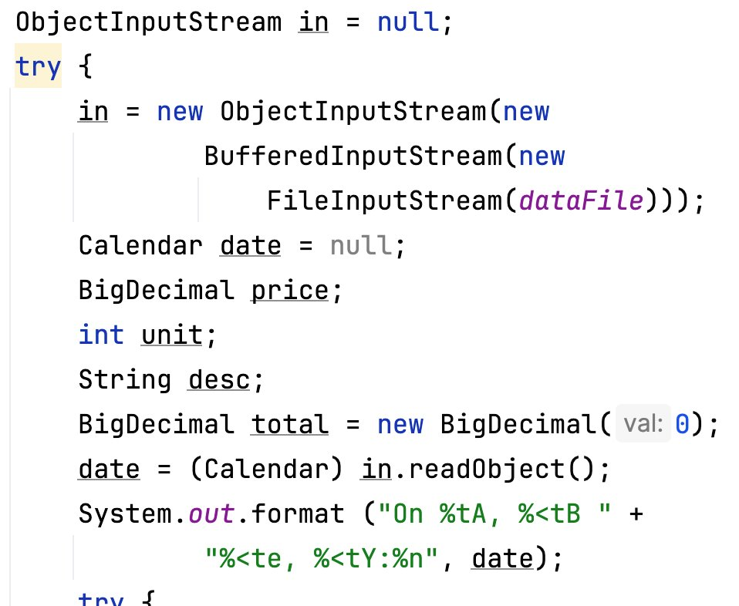
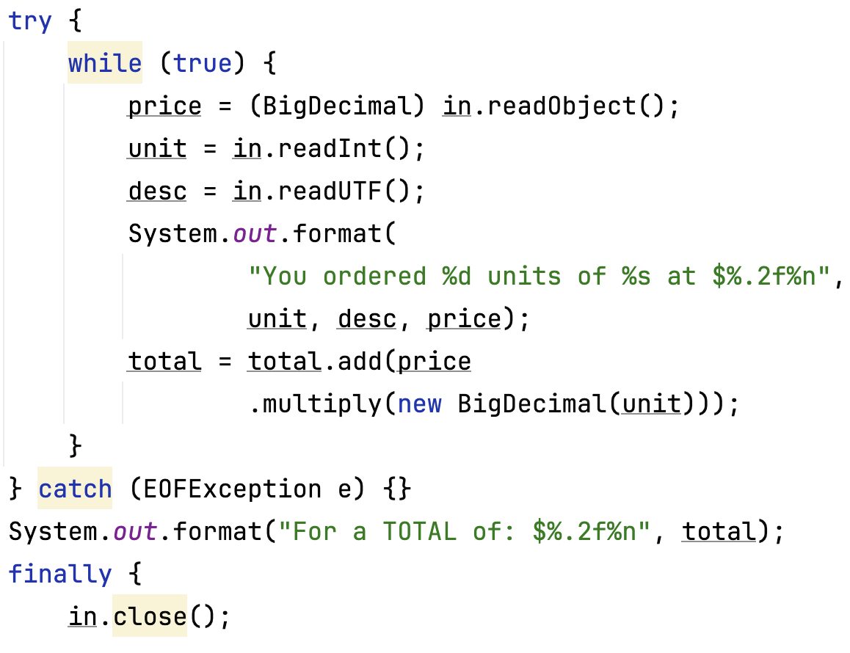
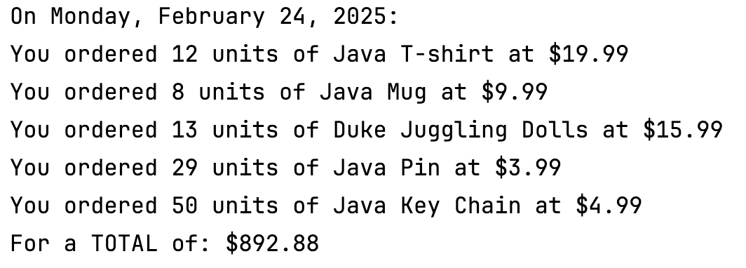
Object Streams
We can write the data structures into an object file, then read it when needed. It's a lightweight method of persisting a Java object.
Note that we need to read the fields in the same order that it was saved.

Slide 23
Reading, Writing, and Creating Files
Commonly used methods for small files
Buffered I/O Methods for Text Files
Methods for Unbuffered Streams
Methods for Channels and ByteBuffers

Slide 24
Commonly Used Methods for Small Files
Reading All Bytes or Lines from a File
Works for a small file that read the entire content in one pass
Not suitable for big files
Writing All Bytes or Lines to a File
Refer to Slide 18 and 19 for examples of file writing and reading

Slide 25
Buffered I/O Methods for Text Files
The java.nio.file package supports channel I/O, which moves data in buffers, bypassing some of the layers that can bottleneck stream I/O.
Reading a File by Using Buffered Stream I/O that can be used to read text from a file in an efficient manner
Writing a File by Using Buffered Stream I/O
Code examples will be provided for both reading and writing

Slide 26
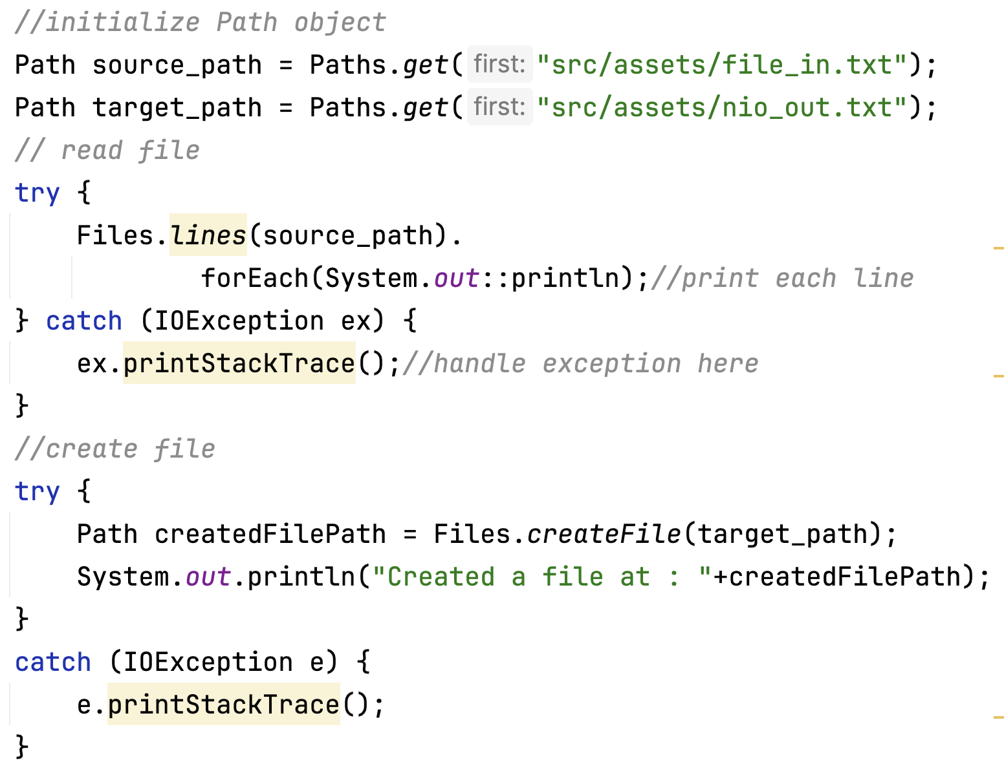
Buffered I/O Example

Slide 27
Methods for Unbuffered Streams
Reading a File using Stream I/O
Creating and Writing a File by Using Stream I/O
Refer to Slide 18 and 19

Slide 28
Methods for Channels and ByteBuffers
Reading and Writing Files by Using Channel I/O
While stream I/O reads a character at a time, channel I/O reads a buffer at a time.
A SeekableByteChannel is a ByteChannel that has the capability to maintain a position in the channel and to change that position.
A SeekableByteChannel also supports truncating the file associated with the channel and querying the file for its size.
The capability to move to different points in the file and then read from or write to that location makes random access of a file possible.
Code examples will be provided

Slide 29
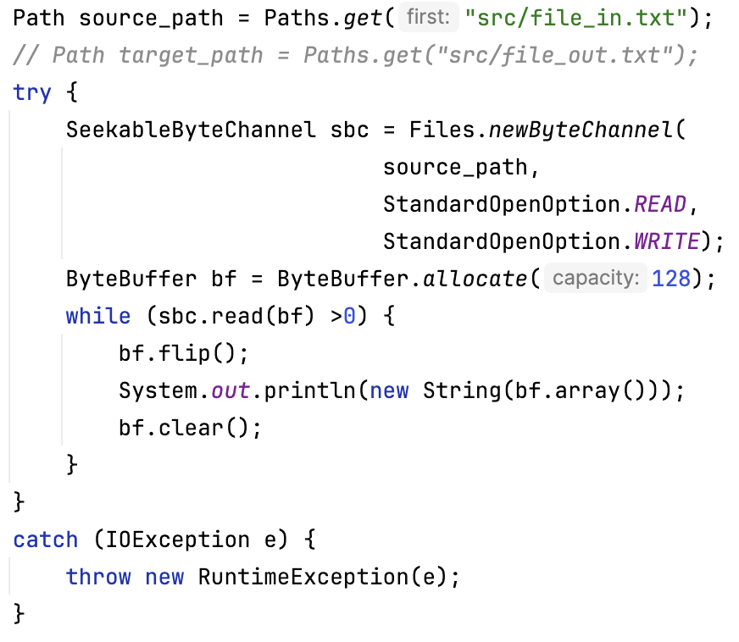
SeekableByteChannel Example: File I/O
Seekablebytechannel is a derived ByteChannel object.
Upon initialization, a seekableByteChannel object needs to be given explicit file operation option(s), in this case, it's a read-and-write object, as indicated by StandardOpenOption.READ and StandardOpenOption.Write parameters.

Slide 30
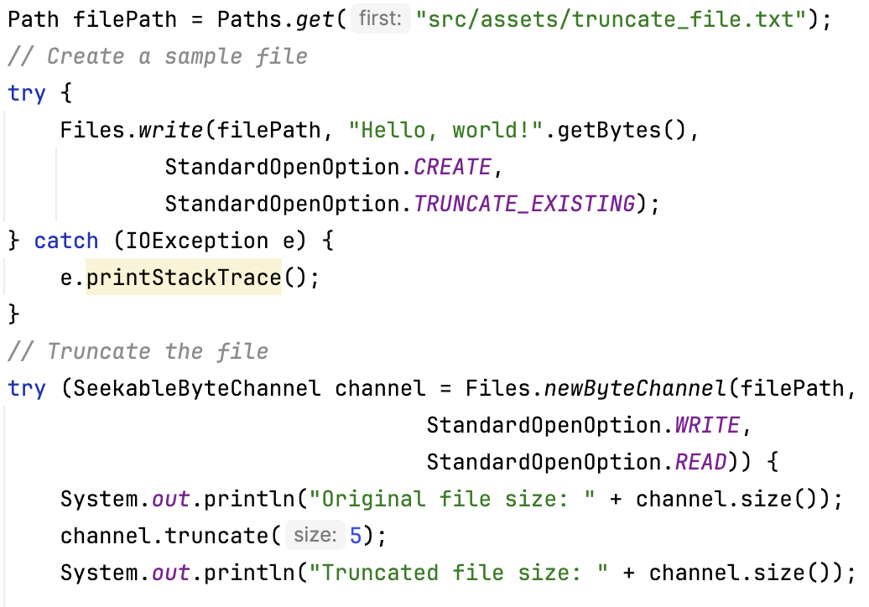
SeekableByteChannel Example: Truncate
Example takes a file with content "Hello, world!" And reduced its content to 5 characters. The truncated content reads "Hello"

Slide 31
Random Access Files
Random access files permit nonsequential, or random, access to a file's contents. To access a file randomly, you open the file, seek a particular location, and read from or write to that file.
Code example will be provided here

Slide 32
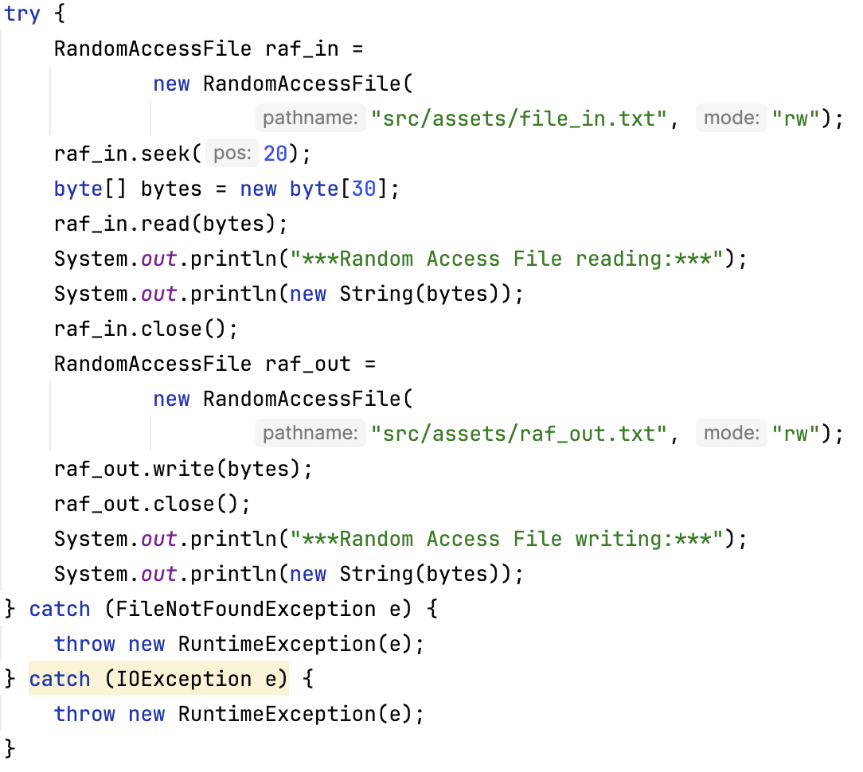
Random Access File Example
RandomAccessFile object can handle reading and writing to a file. And it supports reading a file from a random position.
Similar to seekableByteChannel object, initializing an RandomAccessFile object requires specifying file operation options. In this case, we are giving this object reading and writing access by using "rw".
In this example, the file reading starts from the position 20, and reads the next 30 bytes into the program, and save it to a new file.

Slide 33
Temporal and Spatial Trade-Offs in OO Design
Algorithmic complexity: choosing the right algorithms and data structures
Caching and precomputing to avoid repeated computation
Lazy Evaluation to delay certain computation until they are actually needed to avoid unnecessary computation
Concurrency and parallelism to take advantage of concurrent or parallel processing
Choice of object granularity: Fine-grained objects may increase memory overhead, while coarse-grained objects may lead to wasted memory.
Compression and Serialization: Employing compression techniques or serialized storage formats can reduce the spatial requirements of data storage. However, compression and serialization operations may introduce additional processing overhead.
Understand the performance characteristics of different data structures (e.g. insertion time, retrieval time, memory usage)

Slide 34
Performance Strategies in OO Objects Creation, Deletion, and Insertion
Object creations: minimize object instantiation, use object pooling, lightweight Constructors, lazy initialization
This also applies to setting up any kind of connection, e.g., a TCP network connection with or without encryption, JDBC from Java application to back end database.
Object deletion: efficient garbage collection, resource cleanup (e.g. file handles, database connections, I/O streams)
Object insertion: choose efficient data structures, batch insertion, indexing and sorting, concurrency, minimize memory allocation

Slide 35
Performance Overhead with Inheritance I
Inheritance allows for polymorphism, where derived classes can be treated as instances of their base classes. However, when invoking virtual functions through base class references or pointers, dynamic dispatch is required to determine the appropriate function to call at runtime
Inherited classes typically inherit the members and methods of their base classes. This inheritance can result in larger object sizes, especially if the base class contains a significant amount of data or virtual functions.

Slide 36
Performance Overhead with Inheritance II
When an object is created, all its base classes must be initialized as well. This involves invoking the constructors of the base classes before the derived class constructor is called.
Inheritance can lead to indirect access to member variables and functions. Accessing inherited members through base class references or pointers requires additional indirection and can introduce performance overhead compared to direct access.
If class hierarchies become too deep or complex, it can negatively impact performance by introducing unnecessary levels of indirection, additional function calls, and increased memory usage.

Slide 37
Persistent vs. Transient http Connections Between Web Browser Clients and Web Servers I
http connections go over TCP connections
Browser maintains multiple simultaneous TCP connections to each open web page to enable parallel transmission of objects
Setting up and tearing down a TCP connection for each object moved is expensive
Instead, keep persistent connections for duration of session to enable movements of several objects of varying sizes
text (small), photos, graphics (large), search results (various)
BUT
Tear down connections when done because repeated checking for packet arrivals, packets to send is costly
Dangling sockets could be a security vulnerability
What are the tradeoffs?

Slide 38
Persistent vs. Transient TCP Connections Between Web Browser Clients and Web Servers II
Tradeoffs
Too few connections -> insufficient parallel movement of objects
Too many connections -> listening and keepalive overhead when the connections are quiet
Limit number of connections between a browser and server with the same domain name. For modern browsers, limit usually == 6.
Notice: if connection unavailable when browser wishes to I/O with a server, an exception occurs and the browser must wait until a connection is free.
Can happen if many tabs open to same server simultaneously
Reference: https://docs.diffusiondata.com/cloud/latest/manual/html/designguide/solution/support/connection_limitations.html

Slide 39
JDBC Connections Between Application Server and Back-End Database
JDBC == Java Data Base Connection
If the number of JDBC connections is too small, DB requests must queue for a connection to make a query even if the DB is lightly loaded
Delay in acquiring connection followed by delay to handle query
Example of a software bottleneck
Database administrators sometimes use a small number of JDBCs to artificially throttle requests and prevent overload - not a good mechanism
Instead, enlarge the JDBC pool. Inexpensive to do. Avoids software bottleneck.
Use an overload control mechanism on the DB server to restrict the number of concurrent active DB requests if necessary
Forces queuing within the JDBC, not for the JDBC
Could also throttle the requests at the source by limiting the number of active simultaneous requests

Slide 40
Analogies to Understand Mis-Sizing of Object Pools
Number of cafeteria trays << number of seats -> awkward experience collecting food, returning dirty dishes and cutlery
Inadequate number of trays at airport security causes waiting even if inspectors idle
Number of incoming connections allowed < number of call center operators
Number of supermarket carts exceeds area of interior floor space, causes jamming
Number of commencement tickets for relatives exceeds number of seats for relatives in event facility

Slide 41
Encapsulation and Abstraction
Hiding internal implementation details behind public interfaces
Improve modularity and changeability
Can hide inefficient logic or data structures

Slide 42
Example
public User getUserById(String id) {
for (User u : users) {
if (u.getId().equals(id)) return u; }
return null;}
Clean interface, but linear search = O(n)
Better internal design: use HashMap for O(1) lookup
Design tip: Hide complexity, not inefficiency

Slide 43
Inheritance and Performance Trade-Offs
Deep class hierarchies:
Increase dynamic dispatch cost
Make inlining harder for JVM
Add inherited fields = bigger memory footprint
Use composition where appropriate
Keep hierarchies shallow in performance-critical code

Slide 44
Example
class A {...}
class B extends A {...}
class C extends B {...}
Method doWork() overridden at each level
JVM must resolve actual method at runtime
Can lead to cache inefficiency, GC pressure

Slide 45
Polymorphism and Performance
Polymorphism = calling methods via superclass/interface reference
Enables flexibility and extensibility
But introduces runtime method dispatch overhead

Slide 46
Example
Shape s = new Circle();
s.draw(); // Resolved at runtime
Each call incurs method resolution
Not ideal inside tight loops or real-time systems
Slows JIT inlining and optimizations

Slide 47
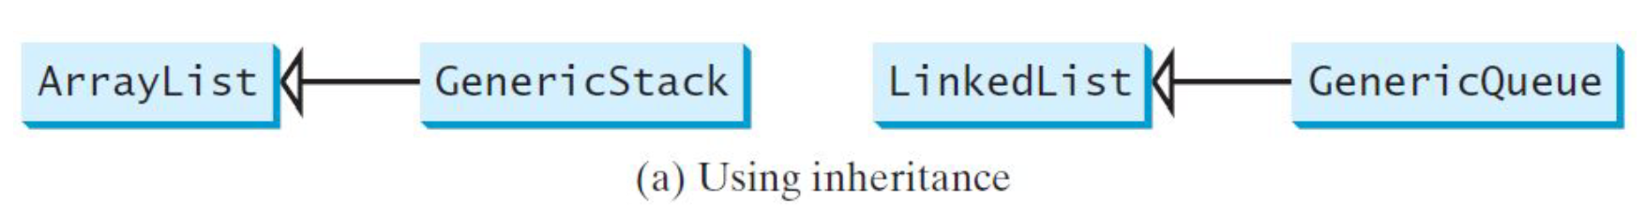
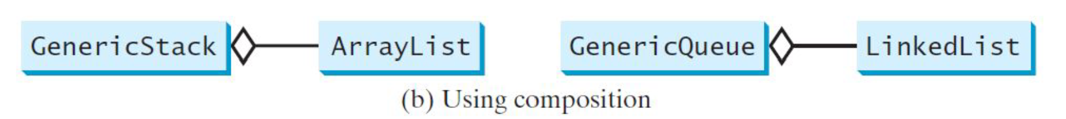
Design of the Stack and Queue Classes (Refer to Lecture 24)
There are two ways to design the stack and queue classes:
– Using inheritance: You can define the stack class by extending the arraylist class, and the queue class by extending the linked list class.
– Using composition: You can define an array list as a data field in the stack class, and a linked list as a data field in the queue class.

Slide 48
Performance-Savvy OO Design Tips
Profile your code before optimizing
Use final methods/classes in hot paths
Prefer composition than deep inheritance
Be aware of cost behind abstractions

Slide 49
Garbage Collection and Performance
Garbage accumulates on the Java heap when objects are created and destroyed
If this happens frequently, garbage collection (GC) will happen more frequently to free up unused memory for allocation to other objects
Performance cost: more CPU usage, more memory management overhead
Heap size too small: collection happens more frequently
Heap size too large: collection might happen less frequently, but there might be more to collect each time, which takes longer
Tuning of heap sizes and parameters to trigger GC can be complicated; much has been written about it
Older versions of Java froze the execution of all threads in the JVM, even those that had no garbage to be collected
Severe reduction in parallel or concurrent activity
This has been remedied now

Slide 50
How to reduce GC?
Selectively create and destroy objects; avoid doing this unnecessarily, especially when objects are large
Consider using persistent objects that last a long time to reduce GC overhead and creation/destruction cost
Risk: if the pool of objects is exhausted when one is needed, processing must wait for one to be freed.
Example of discrete object pool: Java Database Connections for DB query
Always check the most recent literature to see how GC parameters should be set for your type of application

Slide 51
Performance Risks of Garbage Collection
GC slows down execution
It is not under the programmer’s control
Risk in a cyberphysical, or other mission critical system, or in high speed securities trading: execution is delayed or slowed when rapid execution is needed

